Slide 1


Slide 2
SkyLaundry
“Life’s too short for Laundry” so we created SkyLaundry to provide customers with a convenient, flexible and reliable way to have your clothes laundered.
SkyLaundry is a new Laundry-On-Demand service:
Customers want their clothes cleaned
They schedule their laundry to be collected
Drivers collect laundry and take it to the washers
When the laundry is ready they return it to the customers
Every month SkyLaundry bills the customers and pays the drivers

Slide 3



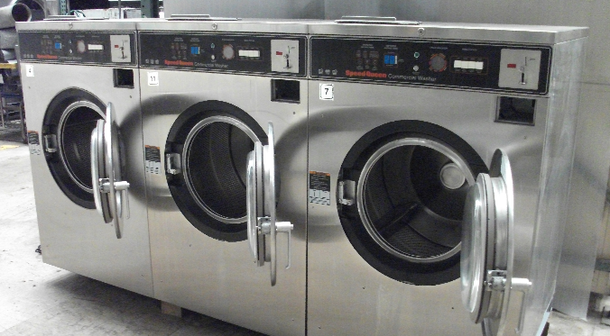
Customer no: 0032882
Laundry bags: 2
Ok
Order:008
Dispatch:008
Washers

Slide 4
Washers

Slide 5
Washers

Slide 6
Washing is processed in 24 Hours
Washers

Slide 7
Return:008
Washers

Slide 8
Washers

Slide 9
Delivered:008
Washers

Slide 10
Washers

